Slide 1
Chapter 3:
Statistical Modeling & Visualization
Notes:
If this PowerPoint presentation contains mathematical equations, you may need to check that your computer has the following installed:
1) Math Type Plugin
2) Math Player (free versions available)
3) NVDA Reader (free versions available)

Slide 2
Learning Objectives
Understand the nature of data as it relates to business intelligence (BI) and analytics
Learn the methods used to make real-world data analytics ready
Describe statistical modeling and its relationship to business analytics
Learn about descriptive and inferential statistics
Understand the importance of data/information visualization
Learn different types of visualization techniques
Notes:
Slide 2 is list of textbook LO numbers and statements

Slide 3
The Nature of Data
Data: a collection of facts
usually obtained as the result of experiences, observations, or experiments
Data may consist of numbers, words, images …
Data is the lowest level of abstraction (from which information and knowledge are derived)
Data is the source for information and knowledge
Data quality and data integrity → critical to analytics

Slide 4
Metrics for Analytics ready Data
Data source reliability
Data content accuracy
Data accessibility
Data security and data privacy
Data richness
Data consistency
Data currency/data timeliness
Data granularity
Data validity and data relevancy

Slide 5
A Simple Taxonomy of Data
Data (datum—singular form of data)
Structured data
Targeted for computers to process
Numeric versus nominal
Unstructured/textual data
Targeted for humans to process/digest
Semi-structured data?
X M L, H T M L, Log files, etc.
Data taxonomy…

Slide 6
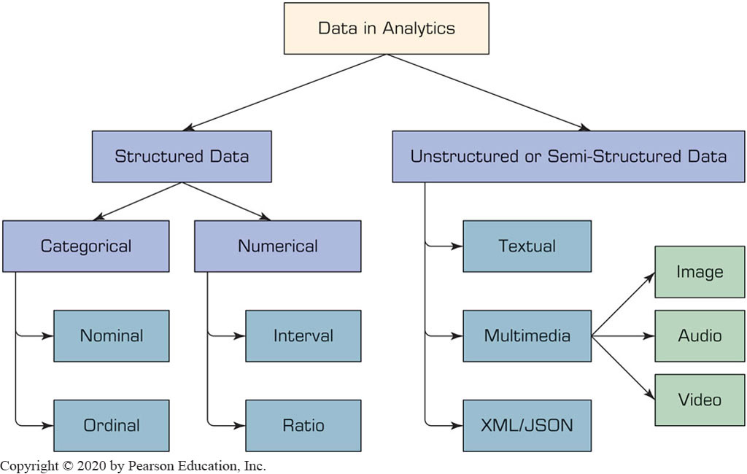
A Simple Taxonomy of Data

Slide 7
The Art and Science of Data Pre-Processing
The real-world data is dirty, misaligned, overly complex, and inaccurate
Not ready for analytics!
Readying the data for analytics is needed
Data preprocessing
Data consolidation
Data cleaning
Data transformation
Data reduction
Art – it develops and improves with experience

Slide 8
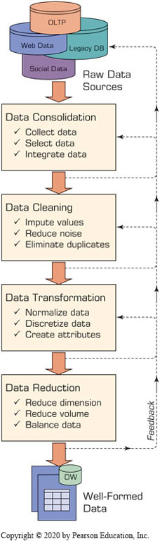
The Art and Science of Data Pre-Processing
Data reduction
Variables
Dimensional reduction
Variable selection
2. Cases/samples
Sampling
Balancing / stratification

Slide 9
Data Preprocessing Tasks and Methods
Table 3.1 A Summary of Data Preprocessing Tasks and Potential Methods.
Main Task | Subtasks | Popular Methods
Data consolidation | Access and collect the data Select and filter the data Integrate and unify the data | SQL queries, software agents, Web services. Domain expertise, SQL queries, statistical tests. SQL queries, domain expertise, ontology-driven data mapping.
Data cleaning | Handle missing values in the data | Fill in missing values (imputations) with most appropriate values (mean, median, min/max, mode, etc.); recode the missing values with a constant such as “ML”; remove the record of the missing value; do nothing.
Blank | Identify and reduce noise in the data | Identify the outliers in data with simple statistical techniques (such as averages and standard deviations) or with cluster analysis; once identified, either remove the outliers or smooth them by using binning, regression, or simple averages.
Blank | Find and eliminate erroneous data | Identify the erroneous values in data (other than outliers), such as odd values, inconsistent class labels, odd distributions; once identified, use domain expertise to correct the values or remove the records holding the erroneous values.
Data transformation | Normalize the data | Reduce the range of values in each numerically valued variable to a standard range (e.g., 0 to 1 or −1 to +1) by using a variety of normalization or scaling techniques.
Blank | Discretize or aggregate the data | If needed, convert the numeric variables into discrete representations using range- or frequency-based binning techniques; for categorical variables, reduce the number of values by applying proper concept hierarchies.
Blank | Construct new attributes | Derive new and more informative variables from the existing ones using a wide range of mathematical functions (as simple as addition and multiplication or as complex as a hybrid combination of log transformations).
Data reduction | Reduce number of attributes | Use principal component analysis, independent component analysis, chi-square testing, correlation analysis, and decision tree induction.
Blank | Reduce number of records | Perform random sampling, stratified sampling, expert-knowledge-driven purposeful sampling.
Blank | Balance skewed data | Oversample the less represented or undersample the more represented classes.

Slide 10
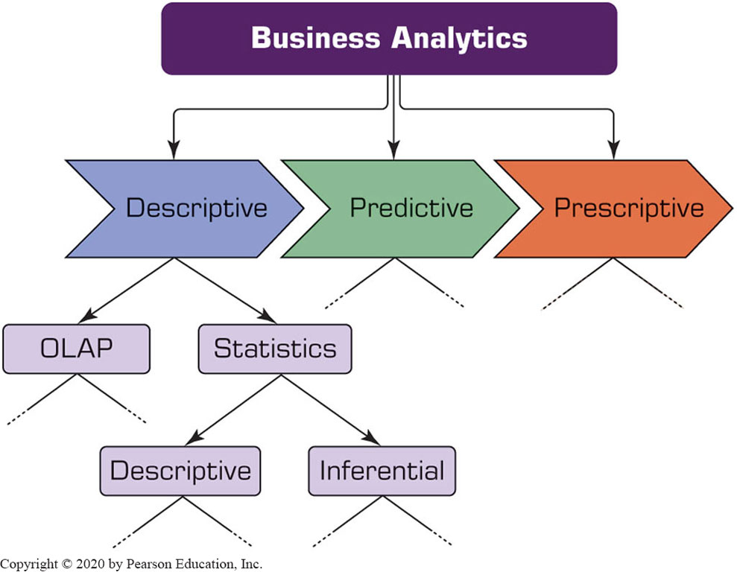
Statistical Modelling for Business Analytics

Slide 11
Statistical Modelling for Business Analytics
Statistics
A collection of mathematical techniques to characterize and interpret data
Descriptive Statistics
Describing the data (as it is)
Inferential statistics
Drawing inferences about the population based on a sample data
Descriptive statistics for descriptive analytics

Slide 12
Descriptive Statistics Measures of Centrality Tendency
Arithmetic mean
Arithmetic mean
Median
The number in the middle
Mode
The most frequent observation

Slide 13
Descriptive Statistics Measures of Dispersion
Dispersion
Degree of variation in a given variable
Range
Max - Min
Variance Standard Deviation
Mean Absolute Deviation (MAD)
Average absolute deviation from the mean

Slide 14
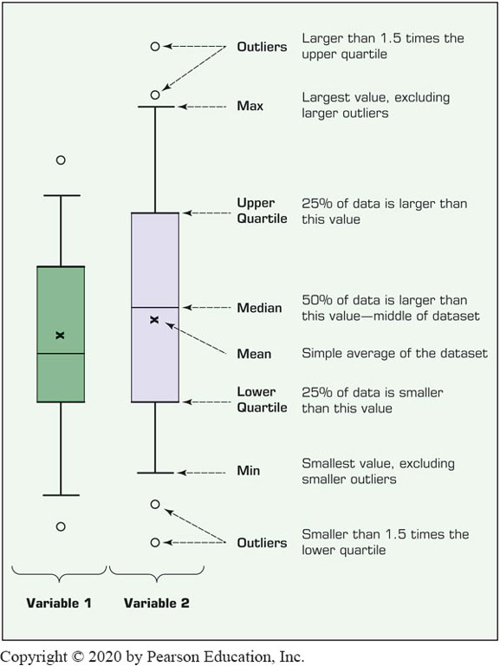
Descriptive Statistics Measures of Dispersion
Quartiles
Box-and-Whiskers Plot
a.k.a. box-plot
Versatile / informative

Slide 15
Descriptive Statistics Measures of Centrality Tendency
Histogram - frequency chart
Skewness
Measure of asymmetry
Kurtosis
Peak/tall/skinny nature of the distribution

Slide 16
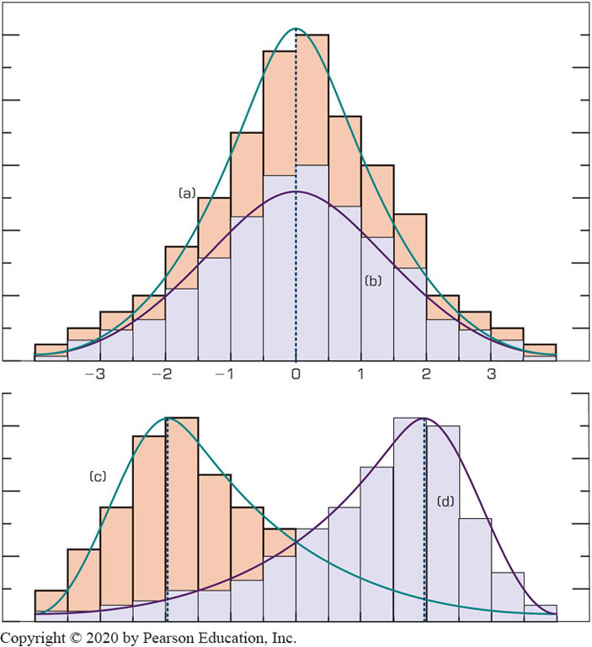
Relationship Between Dispersion and Shape Properties

Slide 17
Regression Modeling for Inferential Statistics
Regression
A part of inferential statistics
The most widely known and used analytics technique in statistics
Used to characterize relationship between explanatory (input) and response (output) variable
It can be used for
Hypothesis testing (explanation)
Forecasting (prediction)

Slide 18
Regression Modeling
Correlation versus Regression
What is the difference (or relationship)?
Simple Regression versus Multiple Regression
Based on number of input variables
How do we develop linear regression models?
Scatter plots (visualization—for simple regression)
Ordinary least squares method
A line that minimizes squared of the errors

Slide 19
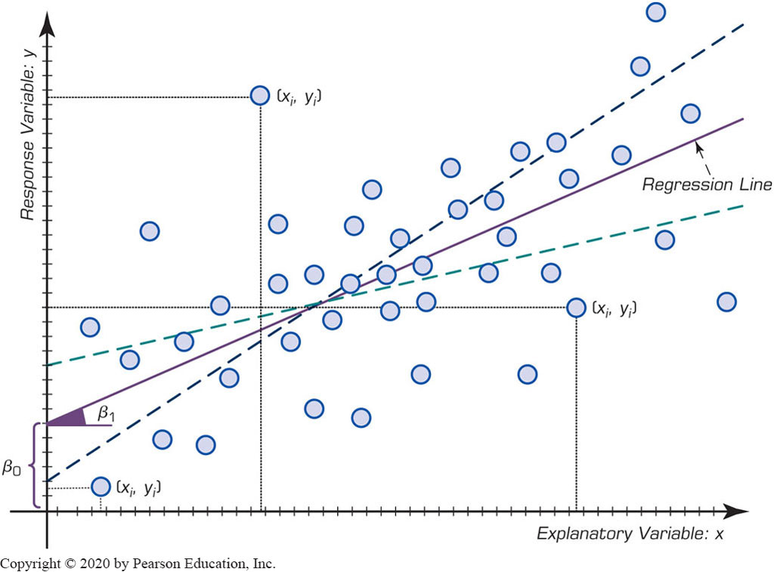
Regression Modeling

Slide 20
Regression Modeling
x: input, y: output
Simple Linear Regression
Multiple Linear Regression
The meaning of Beta (β ) coefficients
Sign (+ or −) and magnitude

Slide 21
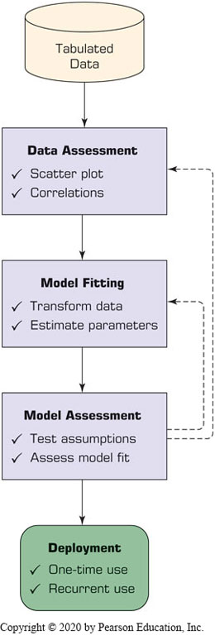
Process of Developing a Regression Model
How do we know if the model is good enough?
R² (R-Square)
p Values
Error measures (for prediction problems)
M S E, M A D, R M S E

Slide 22
Regression Modeling Assumptions
Linearity
Independence
Normality (Normal Distribution)
Constant Variance
Multicollinearity
What happens if the assumptions do NOT hold?
What do we do then?

Slide 23
Logistic Regression Modeling
A very popular statistics-based classification algorithm
Employs supervised learning
Developed in 1940s
The difference between Linear Regression and Logistic Regression
In Logistic Regression Output/Target variable is a binomial (binary classification) variable (as supposed to numeric variable)

Slide 24
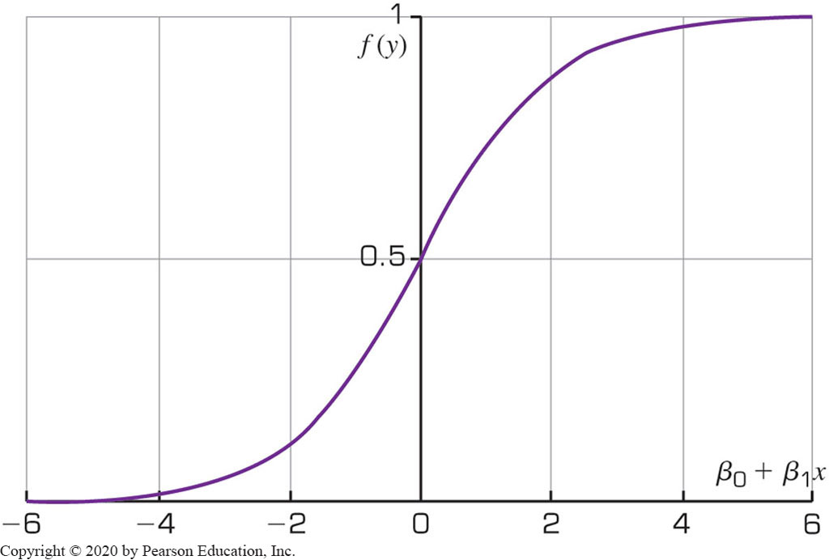
Logistic Regression Modeling

Slide 25
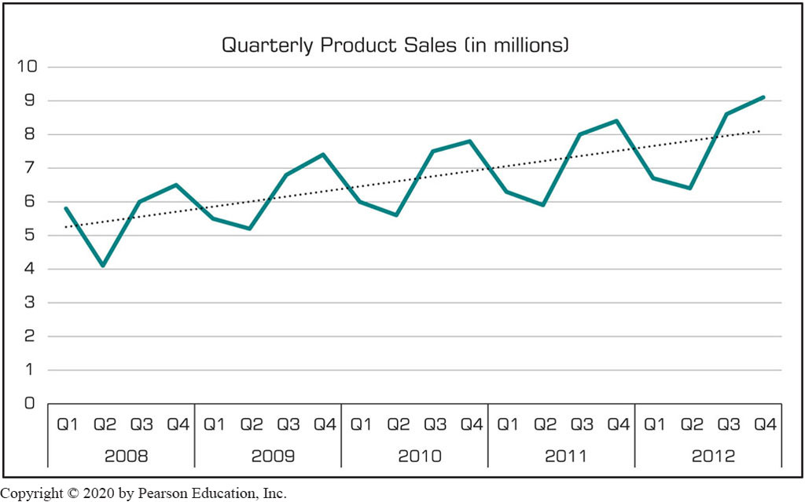
Time Series Forecasting
Is it different than Simple Linear Regression? How?

Slide 26
Data Visualization
“The use of visual representations to explore, make sense of, and communicate data.”
Data visualization vs. Information visualization
Information = aggregation, summarization, and contextualization of data
Related to information graphics, scientific visualization, and statistical graphics
Often includes charts, graphs, illustrations

Slide 27
Visual Analytics
A recently coined term
Information visualization + predictive analytics
Information visualization
Descriptive, backward focused
“what happened” “what is happening”
Predictive analytics
Predictive, future focused
“what will happen” “why will it happen”
There is a strong move toward visual analytics

Slide 28
Performance Dashboards
Dashboards provide visual displays of important information that is consolidated and arranged on a single screen so that information can be digested at a single glance and easily drilled in and further explored
Dashboard design
The fundamental challenge of dashboard design is to display all the required information on a single screen, clearly and without distraction, in a manner that can be assimilated quickly
Three layer of information
Monitoring
Analysis
Management

Slide 29
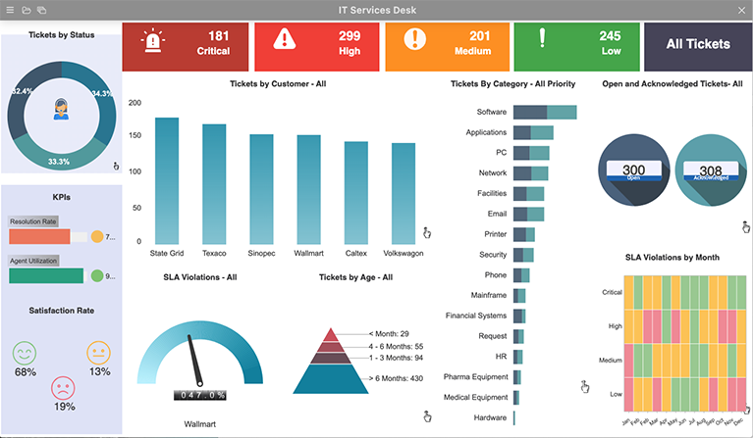
Performance Dashboard

Slide 30
Performance Dashboards
What to look for in a dashboard
Use of visual components to highlight data and exceptions that require action.
Transparent to the user, meaning that they require minimal training and are extremely easy to use
Combine data from a variety of systems into a single, summarized, unified view of the business
Enable drill-down or drill-through to underlying data sources or reports
Present a dynamic, real-world view with timely data
Require little coding to implement, deploy, and maintain

